Slide 1
Contents
Graphics Layers
Scene, Viewport
OGRE Tutorial
  Coordinates and Vectors
  SceneManager, SceneNode and Entity
  Cameras, Lights and Shadows
  Demo programs
DLLs and Plugins
Configuration Files

Slide 2
The World in OGRE3D
A world is a set of layers where the 3D objects acts on
A World
3D Graphics Layers
Frame Buffers
(front + back)

Slide 3


The 3D Graphics Layer
A 3D graphics layer is a projection of the rendering of a 3D world
“Scene” : the 3D world
“Viewport” : the place for projection
Projection Plan
Lights
Camera
3D Models
Board
A 3D Scene

Slide 4
Coordinates and Vectors
X- and Z-axis : horizontal plane,
Y-axis : vertical axis.
No assumptions about
the orientation of models.
Use Vector class to represent
both position and direction
Vector Types:
Vector2, Vector3 and Vector4
Y
X
Z

Slide 5
How does OGRE render a scene?
Four objects are required:
Camera
SceneManager : create Cameras to view the scene
RenderWindow : display everything that can be rendered on the screen
Viewport

Slide 6
OGRE Tutorial One
SceneManager
SceneNode
Entity
An example
  Draw objects on screen
Remark: A large majority of the functions in Ogre have default parameters for them.

Slide 7
SceneManager
Purpose:
Manage everything that is rendered on the screen
For example:
- Keep track of object locations
- Keep track of planes, billboards, lights
- Keep track of cameras

Slide 8
Selecting a SceneManager
Call Root::createSceneManager to select a SceneManager
For example :
mRoot->createSceneManager (ST_GENERIC);
The argument :
specify the type of SceneManager
mRoot : initialized in ExampleApplication::setup

Slide 9
Types of SceneManager
ST_GENERIC - Generic scene manager (Octree if you load Plugin_OctreeSceneManager, DotScene if you load Plugin_DotSceneManager)
ST_EXTERIOR_CLOSE - Terrain_Scene_Manager
ST_EXTERIOR_REAL_FAR - Paging_Scene_Manager
ST_INTERIOR - BSP scene manager
More information: http://www.ogre3d.org/wiki/index.php/SceneManagersFAQ

Slide 10
Entity Basics
Renderable objects : can be rendered on a scene.
An object represented by a 3D mesh.
Things that are NOT Entity: Lights, Billboards, Particles, Cameras
Ogre separates renderable objects from their location and orientation
  -> Cannot directly place an Entity in a scene.
  -> To render, attach the Entity to a SceneNode object, and this SceneNode contains the information about location and orientation.

Slide 11
SceneNode Basics
Purpose: keep track of location and orientation for all of the objects attached to it.
For example,
To render an Entity, attach it to a SceneNode.
It is not an object that is displayed on the screen.

Slide 12
SceneNode Basics
Can be attached any number if objects
e.g. (1) attach Light object around them
(2) Attach an entity to the SceneNode
Can be attached to other SceneNodes
  -> allow to create entire hierarchies of nodes.
Its position is always relative to its parent SceneNode
Each SceneManager contains a root node to which all other SceneNodes are attached.

Slide 13
Getting an Entity and a SceneNode
- Already created
- Call methods of the SceneManager by the name of the Entity or the SceneNode
- SceneManager::getSceneNode : get a SceneNode
SceneManager::getEntity : get an Entity
-> Not necessary to keep track of the pointers of the objects

Slide 14
A program example
- Use (i) ExampleApplication and
(ii) ExampleFrameListener
- Purposes :
(1) Set the ambient light
(2) Create entities
(3) Create scene nodes
(4) Render the meshes of the entities on screen
(5) Translate and rotate objects

Slide 15
(1) Set ambient light
Purpose: see what is rendered on screen.
Syntax:
    SceneManager::setAmbientLight (const ColourValue &):
specify ambient color
Values for red, green, and blue
in the range between 0 and 1.
Code:
CreateScene() {
……
mSceneMgr->setAmbientLight( ColourValue( 1, 1, 1 ) );
……
}

Slide 16
(2) Create an Entity
Code :
Entity *ent1 = mSceneMgr->createEntity(
"Robot", "robot.mesh" );
mSceneMgr : contain the current SceneManager object
(this is done for us by the ExampleApplication class).
createEntity:
- first parameter: set the name;
All entities must have a unique name.
- Second parameter: specify the mesh
Mesh: preloaded by the ExampleApplication class.

Slide 17
(3/4) Create a SceneNode
Code:
SceneNode *node1 = mSceneMgr
->getRootSceneNode()
->createChildSceneNode( "RobotNode" );
Every SceneManager has a root SceneNode.
- SceneNodes have unique name.
After the creation of the SceneNode,
attach the Entity to the SceneNode.
Code:
node1->attachObject( ent1 ); // Now, the Robot has a location.

Slide 18
(3/4) Create a SceneNode
Create another SceneNode :
Entity *ent2 = mSceneMgr
->createEntity(
"Robot2", "robot.mesh" );
SceneNode *node2 =
mSceneMgr
->getRootSceneNode()
->createChildSceneNode(
"RobotNode2", Vector3( 50, 0, 0 ) );
node2->attachObject( ent2 );

Slide 19
Hierarchical scene structure:
Set RobotNode2 as a child of RobotNode.
Entity *ent1 = mSceneMgr->createEntity( "Robot", "robot.mesh" );
SceneNode *node1 = mSceneMgr
->getRootSceneNode()->createChildSceneNode( "RobotNode" );
node1->attachObject( ent1 );
Entity *ent2 = mSceneMgr->createEntity( "Robot2", "robot.mesh" );
SceneNode *node2 = node1->createChildSceneNode(
"RobotNode2", Vector3( 50, 0, 0 ) );
Moving node1 will move node2 along with it
Moving node2 will not affect node1.
For example : node2->translate( Vector3( 10, 0, 10 ) );

Slide 20
Bug?
Entity *ent1 = mSceneMgr->createEntity( "Robot", "robot.mesh" );
SceneNode *node1 = mSceneMgr
->getRootSceneNode()->createChildSceneNode( "RobotNode" );
node1->attachObject( ent1 );
Entity *ent2 = mSceneMgr->createEntity( "Robot2", "robot.mesh" );
SceneNode *node2 = node1->createChildSceneNode(
"RobotNode2", Vector3( 50, 0, 0 ) );

Slide 21
Bug?
Entity *ent1 = mSceneMgr->createEntity( "Robot", "robot.mesh" );
SceneNode *node1 = mSceneMgr
->getRootSceneNode()->createChildSceneNode( "RobotNode" );
node1->attachObject( ent1 );
Entity *ent2 = mSceneMgr->createEntity( "Robot2", "robot.mesh" );
SceneNode *node2 = node1->createChildSceneNode(
"RobotNode2", Vector3( 50, 0, 0 ) );
node2->attachObject( ent2 ); // missed

Slide 22
(5) Transformation
Scale :
node2->scale( 1, 2, 1 );
Rotation:
node1->yaw( Degree( -90 ) );
node2->pitch( Degree( -90 ) );
node3->roll( Degree( -90 ) );
Another way: using a quaternion
node1->setOrientation( … );

Slide 23
About SceneNode
SceneNode::createChildSceneNode has three parameters:
(1) the name of the SceneNode
(2) the position of the SceneNode
(3) the initial rotation (orientation)
There are default values for the position and the initial rotation.

Slide 24
More about SceneNode
Some of the SceneNode Functions:
getPosition and setPosition
translate
scale
Rotation
pitch, yaw, and roll
resetOrientation : reset all rotations
setOrientation, getOrientation

Slide 25
More about SceneNode
Some of the SceneNode Functions:
attachObject
Manipulating the objects that are attached :
  numAttachedObjects, getAttachedObject
  detachObject
  detachAllObjects

Slide 26
Contents
Graphics Layers
Scene, Viewport
OGRE Tutorial
  Coordinates and Vectors
  SceneManager, SceneNode and Entity
  Cameras, Lights and Shadows
  Demo programs
DLLs and Plugins
Configuration Files

Slide 27
DLL and Plugins
Ogre is divided into several groups of shared libraries.
1st group : the library itself and the shared libraries that Ogre relies on.
  OgreMain.dll contains the entire Ogre library
  require a few other libraries such as cg.dll.
    must be included with every Ogre application
-2nd group : plugins
- May be turned on or off
- The filenames start with the "Plugin_" prefix.
  Can create new plugins
  Ogre uses plugins for the render systems (such as OpenGL, DirectX, etc), with the "RenderSystem_" prefix.
  turn off the ability -> remove the appropriate RenderSystem plugin

Slide 28
DLL and Plugins
3rd group : third party libraries and helper libraries.
- Ogre does not include things such as
GUI systems, input control, physics engines.
- GUI : CEGUI library is a GUI system
- DLLs begin with "CEGUI*" and the "OgreGUIRenderer.dll" are part of this.
- Keyboard and mouse input : OSI (an input system), contained in OIS.dll.
Remarks: If the program doesn't use CEGUI but does use OIS, then CEGUI DLLs are not necessary, for example.

Slide 29
Configuration Files
Purpose: control which plugins are loaded, where the application's resources are located.
plugins.cfg :contain which plugins the application uses.
- add or remove : modify the file.
- To remove a plugin : remove the line, or comment it out by putting a # in front of the line
- To add a plugin, add a line like "Plugin=[PluginName]". (do not put .DLL at the end of the plugin name)
Specify the location for plugin: change the "PluginFolder" variable.
- absolute and relative paths
# Defines plugins to load
# Define plugin folder
PluginFolder=./plugin
# Define plugins
Plugin=RenderSystem_Direct3D9
Plugin=RenderSystem_GL
Plugin=Plugin_ParticleFX
Plugin=Plugin_BSPSceneManager
Plugin=Plugin_OctreeSceneManager
Plugin=Plugin_CgProgramManager

Slide 30
Configuration Files
resources.cfg : contain a list of resource directories
- Resources include scripts, meshes, textures, and so on.
- Absolute and relative paths
- Subfolders are not scanned
manually enter them,
e.g. "res\meshes" and "res\meshes\small”
media.cfg : tell Ogre more detailed information about some of the
resources.
ogre.cfg : generated by Ogre's configuration screen
- specific to the individual computer and graphics setup
- should not edit ogre.cfg directly
Remarks: should not distribute ogre.cfg

Slide 31
Configuration Files
Each application MUST have :
(1) "plugins.cfg”
(2) "resources.cfg”
Plugins.cfg
Resources.cfg
# Defines plugins to load
# Define plugin folder
PluginFolder=./plugin
# Define plugins
Plugin=RenderSystem_Direct3D9
Plugin=RenderSystem_GL
Plugin=Plugin_ParticleFX
Plugin=Plugin_BSPSceneManager
Plugin=Plugin_OctreeSceneManager
Plugin=Plugin_CgProgramManager
# Resource locations to be added to the 'boostrap' path
# This also contains the minimum you need to use the Ogre example framework
[Bootstrap]
Zip=./Media/packs/OgreCore.zip
# Resource locations to be added to the default path
[General]
FileSystem=./Media
FileSystem=./Media/fonts
FileSystem=./Media/materials/programs
FileSystem=./Media/materials/scripts
FileSystem=./Media/materials/textures

Slide 32
Tutorial Two
Cameras, Lights, and Shadows
Register the Camera to create the Viewport
Use the Viewport object to set the background color of the scene
Use three types of Light
Cast shadows

Slide 33
Camera
Purpose : View the scene
Can attach to any SceneNode.
Its position is relative to its parents
Use one camera at a time
Control movement methods:
  (1) Functions
    setPosition, yaw, roll, and pitch
  (2) If it’s attached to a SceneNode, perform the movement to the SceneNode.

Slide 34
Creating a Camera
In ExampleApplication::createCamera
Derived a new class from ExampleApplication
and implement createCamera. Add the following line
  mCamera = mSceneMgr->createCamera("PlayerCam");
  create a Camera with the name "PlayerCam".
  mSceneMgr::getCamera : get Cameras based on their name
Set its position and direction :
mCamera->setPosition(Vector3(0,10,500));
mCamera->lookAt(Vector3(0,0,0));

Slide 35
Settings of a Camera
Camera::lookAt : change the facing direction
Clipping distance:
specify how close or far something can be seen
  The near clipping distance : objects in front of camera are not rendered of this clipping plane
    setNearClipDistance
  The far clipping distance : objects at the back of the far clipping plane are not rendered.
    setFarClipDistance
  Side effect: increase the framerate

Slide 36
Code for creating a Camera
class DemoApp : public ExampleApplication {
……
protected:
virtual void createCamera(void) {
mCamera = mSceneMgr->createCamera("PlayerCam");
mCamera->setPosition(Vector3(0,10,500));
mCamera->lookAt(Vector3(0,0,0));
mCamera->setNearClipDistance(5);
}
……
};

Slide 37
Viewport
Motivation: have to tell RenderWindow which Cameras to display on the screen, and what portion of the window to render it in.
Purpose of Viewport : The area in which you tell the RenderWindow to display the objects that the Camera see.
Multiple SceneManagers
  - Split the screen up into multiple areas, and have different cameras to render seperated areas on the screen

Slide 38
Creating a Viewport
In ExampleApplication::createViewports:
Call the addViewport function of RenderWindow and supply it with the Camera
The instance mWindow of RenderWindow is instantiated in ExampleApplication class
Code:
  Viewport* vp = mWindow->addViewport(mCamera);
  vp->setBackgroundColour(ColourValue(0,0,0));
  // Alter the camera aspect ratio to match the viewport
  mCamera->setAspectRatio(
  Real(vp->getActualWidth()) / Real(vp->getActualHeight()));

Slide 39
(0, 0)
(1, 0)
virtual Viewport* Ogre::RenderTarget::addViewport | ( | Camera * | cam,
 |  | int | ZOrder = 0,
 |  | float | left = 0.0f,
 |  | float | top = 0.0f,
 |  | float | width = 1.0f,
 |  | float | height = 1.0f
 | )
 | cam | Camera
 | zOrger | The relative order of the viewport with others on the target (allows overlapping viewports i.e. picture-in-picture). Higher ZOrders are on top of lower ones. The actual number is irrelevant, only the relative ZOrder matters (you can leave gaps in the numbering)
 | left | The relative position of the left of the viewport on the target, as a value between 0 and 1.
 | top | The relative position of the top of the viewport on the target, as a value between 0 and 1.
 | width | The relative width of the viewport on the target, as a value between 0 and 1.
 | height | The relative height of the viewport on the target, as a value between 0 and 1.
(0, 1)
(1, 1)

Slide 40
Shadows
Three Shadow Types:
Modulative Texture Shadows (SHADOWTYPE_TEXTURE_MODULATIVE) - The least intensive of the three.
Modulative Stencil Shadows (SHADOWTYPE_STENCIL_MODULATIVE) - render all shadow volumes as a modulation after all non-transparent objects have been rendered to the scene.
Additive Stencil Shadows (SHADOWTYPE_STENCIL_ADDITIVE) - render each light as a separate additive pass on the scene.

Slide 41
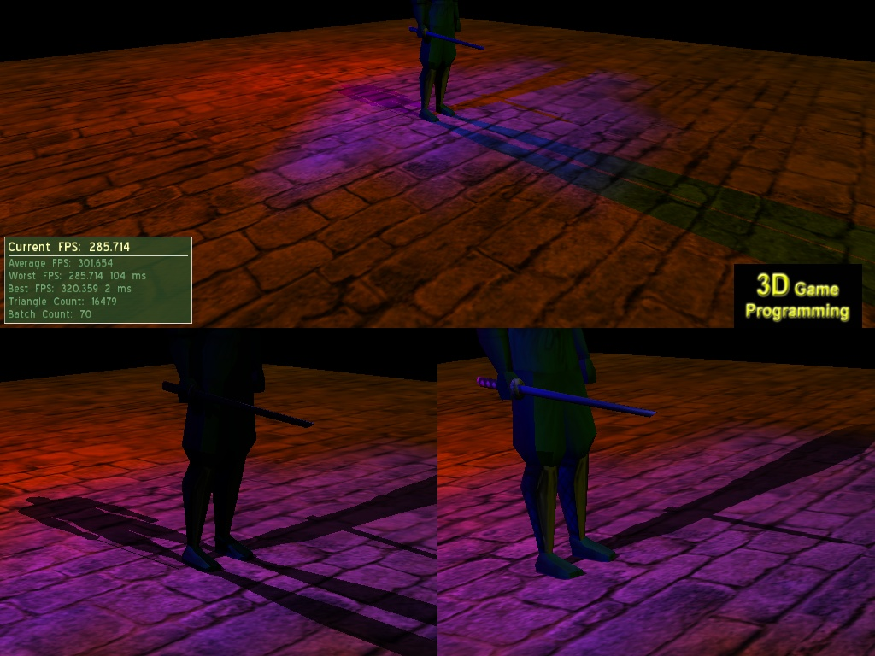
SHADOWTYPE_STENCIL_ADDITIVE
SHADOWTYPE_STENCIL_MODULATIVE
SHADOWTYPE_TEXTURE_MODULATIVE

Slide 42
Shadows
Modulative Texture Shadows (SHADOWTYPE_TEXTURE_MODULATIVE) –
The least intensive of the three.
Two Steps:
- (1) creates a black and white render-to- texture of shadow casters
- (2) applied to the scene.

Slide 43
Shadows
Modulative Stencil Shadows (SHADOWTYPE_STENCIL_MODULATIVE) –
render all shadow volumes as a modulation after all non-transparent objects have been rendered to the scene.
not as intensive as Additive Stencil Shadows,
not as accurate as Additive Stencil Shadows

Slide 44
Shadows
Additive Stencil Shadows (SHADOWTYPE_STENCIL_ADDITIVE) – render each light as a separate additive pass on the scene.
each additional light requires an additional pass at rendering the scene
-> hard on the graphics card

Slide 45
OGRE Shadows
Not support soft shadows
Write vertex and fragment programs
Further reading: The Ogre manual fully describes shadows

Slide 46
Using Shadows
SceneManager::setShadowTechnique : set the type of Shadows.
Entity::setCastShadows : set whether or not the Entity casts shadows.
Code:
In ExampleApplication::createScene
  mSceneMgr->setAmbientLight(ColourValue(0, 0, 0));
  mSceneMgr->setShadowTechnique(
  SHADOWTYPE_STENCIL_ADDITIVE);
  Entity *ent = mSceneMgr->createEntity("Ninja", "ninja.mesh");
  ent->setCastShadows(true);
  mSceneMgr
  ->getRootSceneNode()
  ->createChildSceneNode()
  ->attachObject(ent);

Slide 47
Where is the shadow cast onto?
createPlane
Define a simple plane and put the models on top of it.
Use MeshManager
- Define the Plane object
- Supply a normal and the distance from the origin.
- For example,
(1) facing the positive y axis
(2) distance from the origin = 0
Plane plane(Vector3::UNIT_Y, 0);
Recall : The MeshManager class keeps track of all the meshes loaded into the application

Slide 48
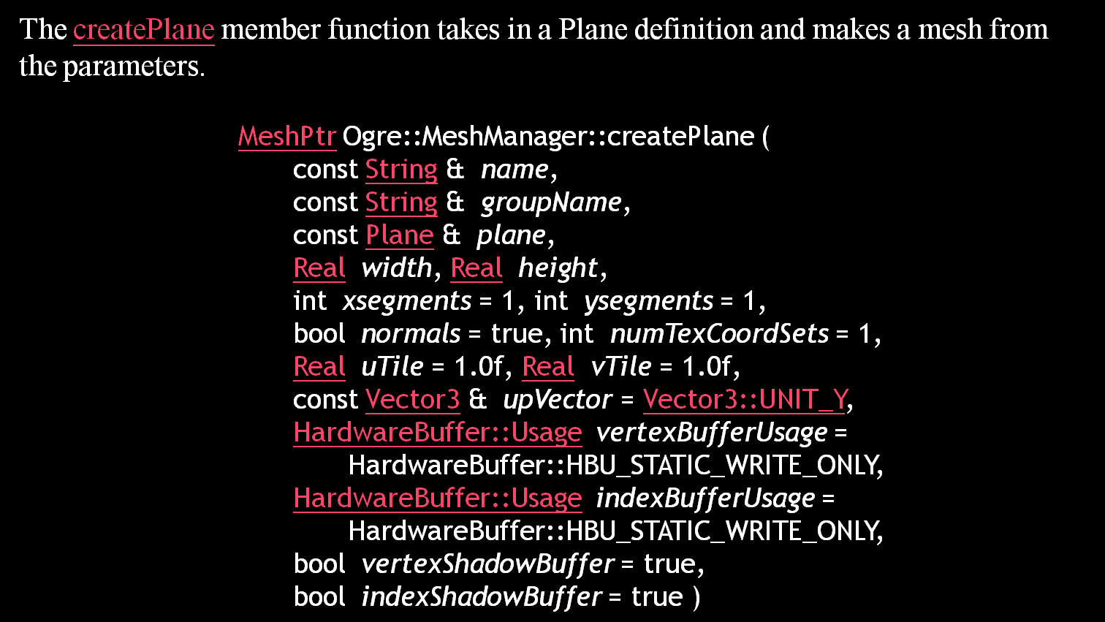
Where is the shadow cast onto?
createPlane

Slide 49
Where is the shadow cast onto?
createPlane
The createPlane member function takes in a Plane definition and makes a mesh from the parameters.
Code:
    MeshManager::getSingleton().createPlane(
    "ground", ResourceGroupManager::DEFAULT_RESOURCE_GROUP_NAME,
    plane,
    1500,1500, // width, height
    20,20, // x- and y-segments
    true, // normal
    1, // num texture sets
    5,5, // x- and y-tiles
    Vector3::UNIT_Z // upward vector
    );

Slide 50
Where is the shadow cast onto?
createPlane
Place the plan on the scene
(1) create an Entity from this mesh
(2) attach the Entity to a SceneNode
Code :
  ent = mSceneMgr->createEntity(
  "GroundEntity", "ground");
  mSceneMgr
  ->getRootSceneNode()
  ->createChildSceneNode()
  ->attachObject(ent);

Slide 51
More things to do…
Tell the SceneManager that the plane shouldn’t be cast shadows :
  ent->setCastShadows(false);
Put a texture on it
Robot and ninja meshes already have material scripts defined for them.
When manually create the ground mesh, no textures.
  Assign texture to it:
ent->setMaterialName("Examples/Rockwall");
After execute the program, what do we see?
Dark -> we need lights

Slide 52
Three types of Lights
Camera
Point (LT_POINT) –
Point light sources emit light from them in every direction.
Spotlight (LT_SPOTLIGHT) –
  A spotlight works exactly like a flashlight does.
- position, direction, inner angle and outer angle
(3) Directional (LT_DIRECTIONAL) –
Directional light simulates far away light that hits everything in the scene from a direction.
- no position (coming from a far off distance)
- direction
Properties of Lights : diffuse and specular color.
Each material script defines how much diffuse and specular lighting the material reflects
setAttenuation : control how the light dissipates

Slide 53
Creating Lights
SceneManager::createLight
supply the light's name
Set the position of it manually or attach it to a SceneNode for movement.
  Manually control:
      setPosition and setDirection
  via SceneNode: should attach it to a SceneNode

Slide 54
Creating a point light
Code:
  Light *light = mSceneMgr->createLight("Light1");
  light->setType(Light::LT_POINT);
  light->setPosition(Vector3(0, 150, 250));
  light->setDiffuseColour(1.0, 0.0, 0.0);
  light->setSpecularColour(1.0, 0.0, 0.0);

Slide 55
Creating a spotlight
Code:
  light = mSceneMgr->createLight("Light2");
  light->setType(Light::LT_SPOTLIGHT);
  light->setDiffuseColour(0, 0, 1.0);
  light->setSpecularColour(0, 0, 1.0);
  light->setDirection(-1, -1, 0);
  light->setPosition(Vector3(300, 300, 0));
  light->setSpotlightRange(Degree(35), Degree(50));
setSpotlightRange : set the inner and outer angles.
Remark: inner angle only applied to Direct3D; for OpenGL, inner angle := 0

Slide 56
Creating a directional light
Code:
  light = mSceneMgr->createLight("Light3");
  light->setType(Light::LT_DIRECTIONAL);
  light->setDiffuseColour(ColourValue(.25, .25, 0));
  light->setSpecularColour(ColourValue(.25, .25, 0));
  light->setDirection(Vector3( 0, -1, 1 ));

Slide 57
Multiple SceneManagers
Steps:
Create SceneManagers :
    Root::createSceneManager
Create cameras for each SceneManager : SceneManager::createCamera
Create a viewport for each Camera :
  RenderWindow::addViewport
Create objects for each SceneManager

Slide 58
Multiple SceneManagers
void DemoApp::chooseSceneManager()
{
Primary_SMGR = mRoot
->createSceneManager(ST_GENERIC, "primary");
Secondary_SMGR = mRoot
->createSceneManager(ST_GENERIC, "secondary");
}

Slide 59
Multiple SceneManagers
void DemoApp::createCamera()
{
Camera *c0, *c1;
// mCamera is passed to the FrameListener
// when calling ExampleApplication::createFrameListener
// Thus, we have to set a value for it.
c0 = mCamera = Primary_SMGR->createCamera(PRIMARY_CAMERA_NAME);
c1 = Secondary_SMGR->createCamera(SECONDARY_CAMERA_NAME);
c0->setPosition(Vector3(0,0,500));
// Look back along -Z
c0->lookAt(Vector3(0,0,-300));
c0->setNearClipDistance(5);
//
c1->setPosition(Vector3(0,0,500));
// Look back along -Z
c1->lookAt(Vector3(0,0,-300));
c1->setNearClipDistance(5);
}

Slide 60
Multiple SceneManagers
void DemoApp::createViewports()
{
mWindow->removeAllViewports();
Viewport *vp = 0;
Camera *c;
c = Primary_SMGR->getCamera(PRIMARY_CAMERA_NAME);
vp = mWindow->addViewport(c);
vp->setBackgroundColour(ColourValue(0, 0, 0));
c->setAspectRatio(
Real(vp->getActualWidth())
/ Real(vp->getActualHeight()));
//
c = Secondary_SMGR->getCamera(SECONDARY_CAMERA_NAME);
vp = mWindow->addViewport(c, 1, 0.5, 0.5, 0.5, 1);
vp->setBackgroundColour(ColourValue(0.5, 0.5, 0.5));
c->setAspectRatio(
Real(vp->getActualWidth())
/ Real(vp->getActualHeight()));
}

Slide 61
Multiple SceneManagers
void DemoApp::createScene()
{
Primary_SMGR->setAmbientLight( ColourValue( 1, 1, 1 ) );
Entity *ent1 = Primary_SMGR->createEntity(
“robot", "robot.mesh" );
SceneNode *node1 = Primary_SMGR
->getRootSceneNode()
->createChildSceneNode( "RobotNode" );
node1->attachObject( ent1 );
……..
Secondary_SMGR->setAmbientLight( ColourValue( 1, 1, 1 ) );
Entity *ent3 = Secondary_SMGR->createEntity(
"Robot3", "robot.mesh" );
SceneNode *node3 = Secondary_SMGR
->getRootSceneNode()
->createChildSceneNode( "RobotNode" );
node3->attachObject( ent3 );
…….
}

Slide 62
References:
SceneNodes, Entities
http://www.ogre3d.org/wiki/index.php/Basic_Tutorial_1
Lights, Shadows
http://www.ogre3d.org/wiki/index.php/Basic_Tutorial_2
Using Multiple Scene Managers
http://www.ogre3d.org/wiki/index.php/Basic_Tutorial_8

